Slide 1
Comparisons with the Great Depression
Harold James
Princeton University
Ancona, December 19, 2015

Slide 2
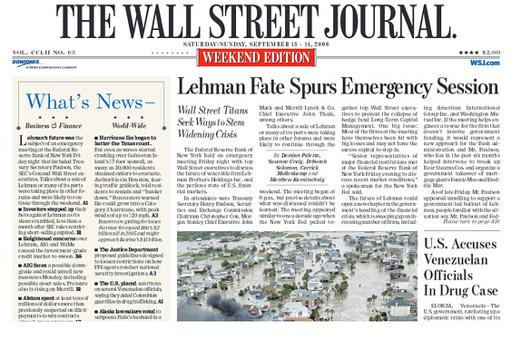
A constant memory

Slide 3
Ben Bernanke, September 13, 2008
My mind went back to my own studies of the Great Depression of the 1930s. The most catastrophic financial failure of that period was the collaspe of the Kreditanstalt, the largest bank in Austria. Its failure toppled other banks and, perhaps, helped derail nascent economic recoveries in the United States and Europe.
(The Courage to Act, p. 264)

Slide 4

Lessons from the Great Depression?

Slide 5
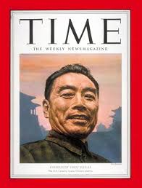
Too early to tell?

Slide 6
Analogies
Long lived crises
Anemic recoveries
Search for explanation of causes
Challenge to domestic order/democracy
Challenge to prevailing international political order

Slide 7
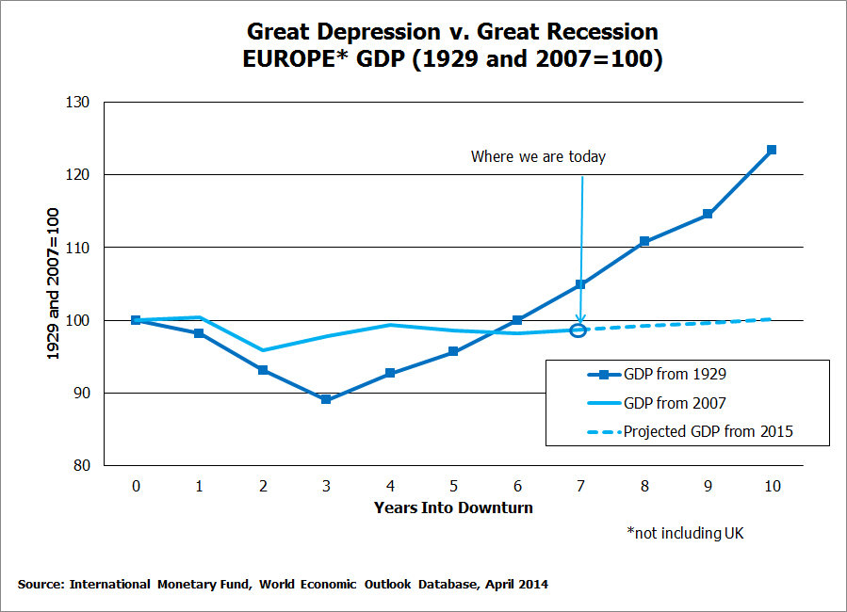
European Recoveries?

Slide 8
Industrial Production 1928-1939

Slide 9
Financial Crises
Downturns last longer (Rogoff/Reinhardt)
Populist politics (anger about bank bailouts)
National orientation (bank regulation easier in national context)
Learning problematical: “We didn’t know we could do that.”

Slide 10
Capital Flow Reversals

Slide 11
Current Account Surpluses and Deficits

Slide 12
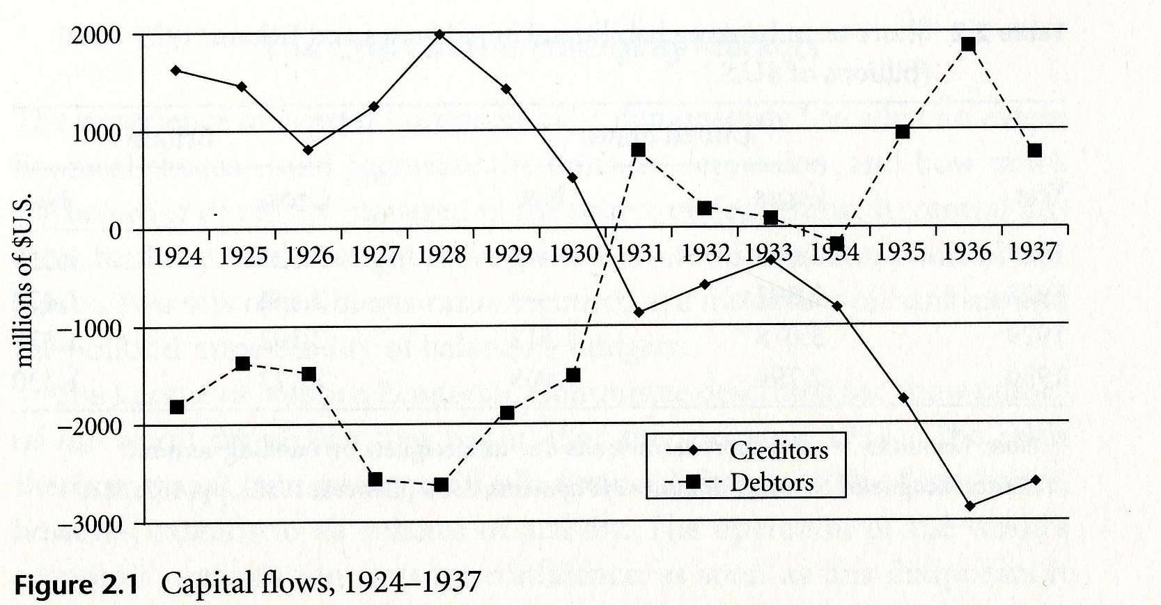
Interwar Reversal
From: Harold James, The End of Globalization, 2001

Slide 13
Eurozone: Limited reversals?
Current account as a share of GDP
Source: IMF WEO database October 2015

Slide 14
Bank Flows

Slide 15
German Banking Claims
(Ultimate Risk Basis million USD) Source: BIS

Slide 16
Claims on Italy
(Ultimate Risk Basis million USD) Source: BIS

Slide 17
Bargaining Styles
Merkel (May 2010): If the Euro fails, Europe fails
Tremonti (July 2011): If I fall, then Italy falls. If Italy falls, then so falls the euro. It is a chain.
Juncker (November 2015): A single currency does not exist if Schengen fails. It is not a neutral concept.

Slide 18
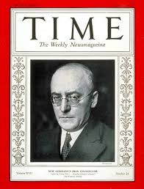
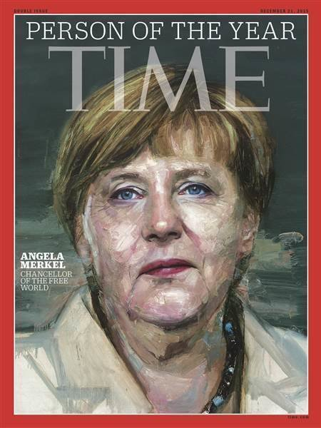

Slide 19
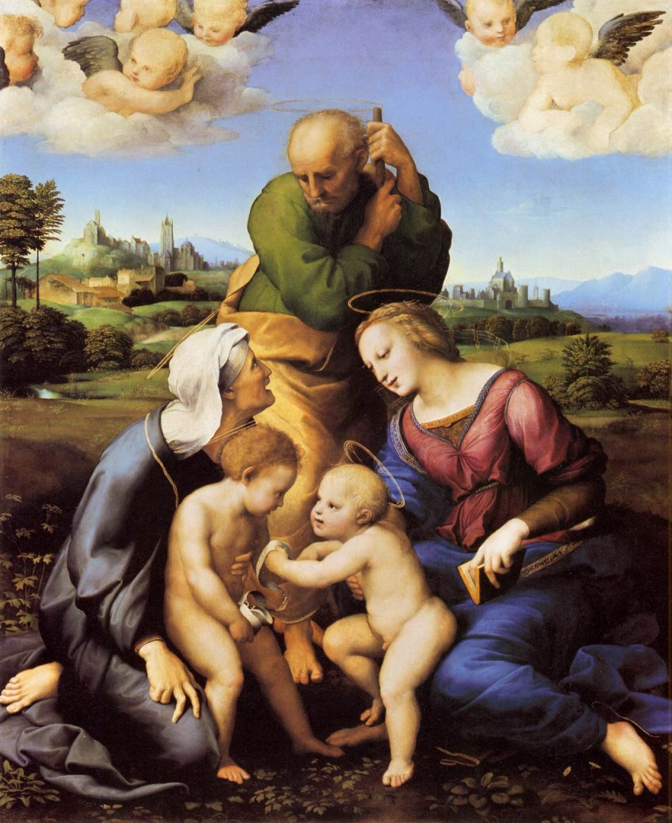
Impossible Trinities/ Trilemmas

Slide 20
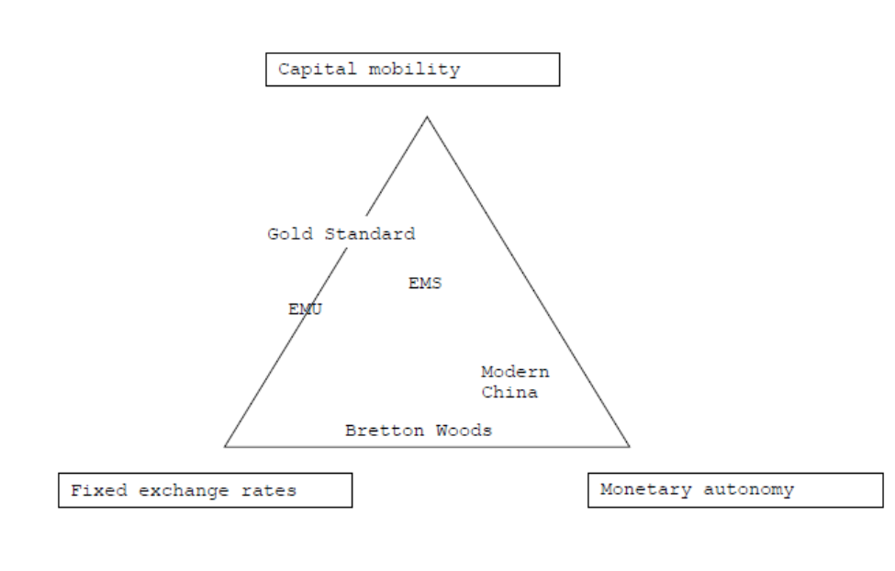
Trilemma 1: The Classic

Slide 21
Trilemma 2: Financial Stability

Slide 22
Trilemma 3:Political Economy

Slide 23
Trilemma 4: International relations

Slide 24
Multiple Crises: Interwar
Economic order (liberalism/capitalism)
Democratic system
International order

Slide 25
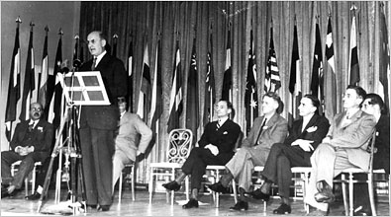
Addressing the problem

Slide 26
Multiple Crises: Today
2008: the Great Recession/World Financial Crisis/Three Stage Crisis?
The Democratic Recession since 2006 (Larry Diamond)
Legitimacy of International Institutions (UN, IMF, G20) strained

Slide 27
Allowing for bundling/packages
“globalisation” in French
Issue linkages

